Slide 1


LLTC Strategic Enrollment Management Plan (SEM) 2026-2030)
Approved by: DAIR
Date: 05/2026

Slide 2
SEM Overview
1
2
3
Leech Lake Tribal College recognizes that recruitment and retention are shared responsibilities across faculty, staff, and administration. The College is committed to a holistic, culturally grounded approach to student success that reflects Anishinaabe values and supports students academically, socially, and personally throughout their educational journey. Student success is achieved through relationship-based engagement, culturally responsive practices, and a coordinated system of academic instruction and student support services.
Current Performance
Future Market Assessment
Outcomes
Strategic Plan Alignment
Key Accomplishments and Metrics
Market Prioritization
Implementation Timeline
Performance Scorecard
Supplementary Resources
Enrollment
Market Forces Summary
Market Demographics
Feeder Institutions
Labor Market Trends
Competitors
Public Policy Impact
Market Segment Assessments

Slide 3
SEMS Goals and Priorities
Strategic Plan Goals
Describe your institution’s strategic plan goals here
The College aims to achieve a five percent annual increase in new student enrollment over the 2026 to 2030 planning period. This includes first time students, returning stop-out students, and students entering through partnerships and community engagement efforts.
This goal reflects institutional capacity, regional population considerations, and the College's relationship-centered recruitment approach grounded in Anishinaabe values. This would be an enrollment projection of between 5 and 7 new students for each of the A.A and A.A.S programs and 1 to 3 students for the certificate and diploma programs. This is a moderate growth analysis based on economic trends, MN workforce demands, and college trends.
SEM Priorities
Describe the purpose and priorities of your strategic enrollment management plan to ensure they align with the goals of the Strategic Plan
Strengthen relationship-centered, community-based recruitment
Reengage stop-out, drop-out students with earned credits
Improve retention and persistence through early, coordinated intervention
Expand integrated academic and wellness support to reduce barriers
Use data-informed decision making to drive continuous improvement

Slide 4
Enrollment Calculator
Calculate New Enrollment Potential Based on Marketing Gains (Double click in the calculator to get to the excel template to add values.
Fill in based on current enrollment data
Minnesota High School Graduates by District Totals: MN OHE (2024-2025)
- Detroit Lakes District Total: 239
- Bemidji Public School District Total: 352
Blackduck Public School District: 38
Cass Lake-Bena Public Schools: 76
Bagley Public Schools: 66
Deer River Public School District: 47
Fosston Public School District: 38
Clearbrook-Gonvick School District: 31
Total Counts: 887
Meet with campus stakeholders to determine likely enrollment increase based on current capacity and expected investment
Use Census and National Center for Education data (linked here) to determine size of opportunity market.
Enter in regional information (e.g., zip code) in search bar, and select 2017 American Community Survey for most up-to-date population data.
High school look up tool:
Public school enrollment | KIDS COUNT Data Center (Raw Data Files)
To Edit the Graph: To edit the calculator, right click on the chart below, select “Worksheet Object” and then “Edit”
Cass County has 4, 400 students, Hubbard County has: 2,498

Slide 5
Enrollments of Focus
Expected Enrollment Change by 2026-2027
Implications of Changes in Enrollment
The projected FA 2027 enrollment indicates overall institutional stability, with modest net growth concentrated in specific programs rather than uniform expansion across the college. This pattern suggests that broad enrollment growth at LLTC will be driven by intentional program-level strategies, not generalized recruitment alone. Maintaining stability near current headcount levels while selectively strengthening high-demand programs aligns with LLTC’s capacity, mission, and community context.
Implication: SEM efforts should focus on program-specific recruitment, retention, and scheduling strategies, rather than institution-wide growth targets that may overextend limited resources in specific programs (ELEC1, RC, IRB).

Slide 6
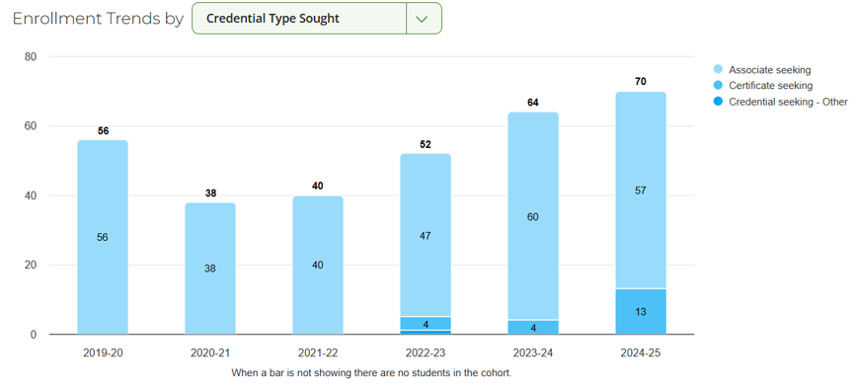
Enrollments by Credential Type
Student Segment Proportion Change Over Time
Implications of Changes in Enrollment
- Associate degrees remain the enrollment anchor, so retention, advising, and course scheduling in degree pathways will continue to have the greatest impact on overall enrollment and completion.
Growing certificate demand signals opportunity to attract adult and workforce learners, but requires clear pathways into advising, financial aid, and employment outcomes to sustain success.
Diversifying credential mix increases service complexity, meaning LLTC must balance supports for full-time degree seekers with flexible, short-term options for part-time students.
Enrollment gains depend more on persistence than recruitment, making early alert academic support, and coordinated student services critical to maintaining and growing enrollment across credential types.

Slide 7

Summary of Market Forces Impacting LLTC (2025-2026)
Market Analysis for LLTC and Northern Minnesota Region
Demographics
-Rural Remote
-Economically and Demographically Challenged Area
-Lack of transportation, childcare, or internet/technology resources.
-Higher percentage of non-traditional students
Feeder Institutions
-Bemidji Public School District
-Cass Lake-Bena Public School Dist.
-Clearbrook-Gonvick Public School District: Potential
-Bagley Public School District: Potential
-Deer River Public School District: Potential
- Blackduck Public School District: Potential
Labor Market
High demand for multi-skilled trades workers.
High demand for health care and law enforcement.
Moderate demand, natural resources.
Competition
Northwest Technical College
Bemidji State University
Red Lake Nation College
White Earth Tribal and Community College
Univ of MN : Detroit Lakes
Public Policy
TCCUAA Act: Regulations and funding
Title III and Title IV funding levels
Federal discretionary funding tied to student success and workforce priorities.
BIE funding
Market Opportunity Cost
-LLTC’s market opportunity cost is approximately 20-30 students per year, representing $120,000.00-210,000 annually and roughly $600,000 per a 5- year SEM cycle, even under conservative assumptions and projections.

Slide 8
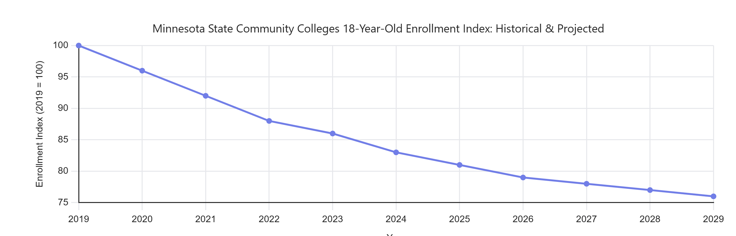
Demographics: Projected State-Wide Growth of Traditional Community Colleges and other TCU College Students
Historical and Projected State Community College 18-Year-Old Enrollments
Minnesota Projections, 2012-2029
Proposed Institutional Response to Changes in Traditional Student Population: A smaller pool of traditional students requires the college to shift enrollment focus to different markets.
18-24 Year-Olds | 2019-2024 shows documented declines in 18-year old college enrollment following demographic shifts, FAFSA disruptions, and pandemic post-impacts. Other factors are Minnesota’s continued reporting of low birth –rate cohorts reaching college age (National Student Clearing House). The market shows an increase of older, working adults seeking career changes, advanced technical training, or trades skills development and certification (Minnesota Office of Higher Education, National Student Clearinghouse, 2019-2024).
New Market Segment | Adults with some college but no credential (stop-out/drop-out) Community members seeking short-term certificates or stackable credentials Working adults balancing employment, family, and schooling, and learners motivated by career advancement, or local workforce needs.
Alternative Options for Response | Expand PSEO and concurrent enrollment with structured transition pathways into associate or certificate programs. (Short-term stackable certificates) Convert early college participation into guaranteed first-year enrollment through advising and a summer bridge program.

Slide 9
Demographics: Projected Graduating Class Size at Five Local High Schools
Current X College Attendance and Projected Graduating Class Size, 2024-2025
Proposed Institutional Response to Changes in Feeder High Schools: E.g. A smaller pool of traditional students requires a shift in enrollment focus to different markets and precipitates a decrease in dual enrollment participation under current norms. HS 4 provides room for growth in both size and relation to market penetration of other high schools. To maintain dual enrollment participation, investments in program review, marketing, and recruitment must be made.
18-24 Year-Olds | The pool of traditional‑age students is contracting due to smaller graduating class sizes in regional feeder high schools, increasing competition for direct‑from‑high‑school enrollees and limiting organic enrollment growth.
Dual Enrollment Segment | Under current participation norms, dual enrollment growth is constrained by declining high‑school cohort size, requiring expanded penetration into additional high schools and stronger value propositions to maintain participation levels.
Institutional Response: | LLTC will shift enrollment emphasis toward adult learners while strategically investing in dual enrollment through targeted program review, enhanced high‑school partnerships, and focused marketing to grow participation across a broader set of feeder schools and stabilize overall enrollment.

Slide 10
Major Student Feeders
Institution | Students Sent in 2025 | Opportunity Size | Anticipated Growth | Comments
Bemidji Public School District | 15-20 | Medium | Low-Moderate | Large graduating classes, but strong competition from Bemidji State, NTC, and other MN State Colleges. Opportunities are strongest in workforce and Indigenous-aligned pathways.
Cass Lake-Bena School District | 7-10 | Small, but strategic to the area and need | Moderate | Core service-area district; strong mission alignment and community ties; growth likely through deeper advising, dual enrollment transition, and summer bridge strategies.
Bagley Public School District Potential | 2-4 | Small to Medium | Moderate | Smaller cohorts but limited local postsecondary options; opportunity to expand awareness and relationships, especially for certificate and transfer pathways.
Clearwater –Gonvick Public School District | 1-3 | Small | Low-Moderate | Very small graduating cohorts; potential impact through individualized outreach and adult-reentry, rather than traditional pipeline growth.
Proposed Institutional Response to Changes in Major Student Feeders: E.g., Anticipated growth and low market penetration at Governor High School as well as Widget Making Certificate provide opportunities, but both require marketing and recruitment investment required; Midtier State University reverse transfer requires investment in website and process review.
Bemidji Public School District | Maintain a focused but selective recruitment presence emphasizing LLTC’s culturally grounded programs, workforce-aligned certificates and Indigenous Leadership pathways. Strengthen differentiation through relationship-based outreach rather than broad marketing.
Cass Lake-Bena School District | Prioritizing intensive relationship-based engagement, expanded dual enrollment transition supports and early advising to increase capture of graduating seniors. Invest in summer bridge and first-year persistence efforts to strengthen this core service-area pipeline.
Bagley Public School District Potential Clearwater –Gonvick Public School District | Bagley: Develop targeted outreach efforts and visibility efforts, including school visits and community events, to build awareness of LLTC as a local, affordable option. Emphasize certificate and transfer pathways aligned to workforce and adult learner interests. Clearwater: Pursue low-cost, high-touch recruitment strategies focused on individualized outreach and adult re-entry rather than large cohort growth. Explore partnerships with teachers and community members to short-term credentials and stackable pathways.

Slide 11
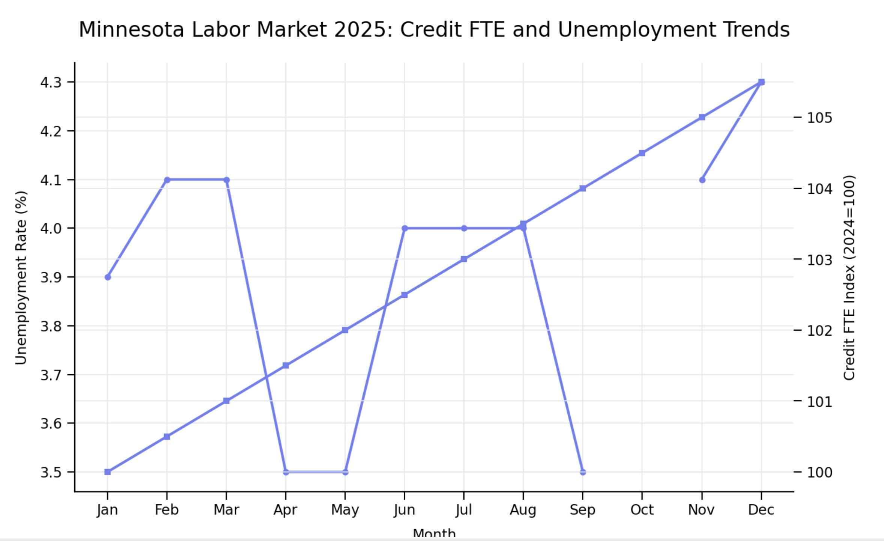
Labor Market 2025 Analysis Minnesota
Industries |  | Occupations
Top 5 Growing | Top 5 Declining | Top 5 Growing | Top 5 Declining
Healthcare and Social Assistance | Publishing, Telecommunications, Broadcasting | Wind Technologies Renewable Energy | Office administration workers: Automation
Construction | Finance: Banking, Insurance, and Real-Estate | Nurse Practitioners | Secretaries and admin assistance: Role Consolidation
Education Services | Professional and Business Services: Corporate offices, management, consulting, administrative support | Epidemiologists Public Health Analytics | Data Entry Keyers: Automated data systems
Government/State and Local | Manufacturing | Data Scientists | Sales: E-commerce cause
Personal and Repair Services | Leisure and Hospitality | Statisticians Research | Word processors and typists: AI
Proposed Institutional Response to Labor Market Changes: E.g. Certain areas of manufacturing are seeing a resurgence in our local economy, due to local and international automobile manufacturer investments. This economic growth provides opportunities through program review and PLA to provide pathways for those in the manufacturing, tech, and health industries to upskill in the machinist and other growing manufacturing trades.
Industry Implication | Minnesota is experiencing growth in healthcare, construction, renewable energy, and selective advanced manufacturing.
Occupation Implication | Demand is increasing for healthcare practitioners and support workers, skilled trades, data and technical roles and renewable energy technicians.
Answer to Shifts | LLTC will use program review, credential alignment, and prior learning assessment to expand, adapt, or streamline programs in high –growth fields while supporting displaced workers’ transitions through stackable credentials and short-term training pathways.

Slide 12
Competitors: Market Competition Assessment
Institution | Key Areas of Competition | New Programs and Facilities | Risk to Market Share
Primary Competition
Bemidji State University Northwest Technical College Red Lake Nation College White Earth Tribal and Community College | Competes with LLTC for transfer-oriented students through expanded online bachelor’s pathways and regional dual-credit enrollment agreements. Competes via short-term technical certificates, and trades. Competes in culturally grounded programming, Native-serving student support and tribal-nation based enrollment Competes in Indigenous-based associate degrees, MnTC transfer curricula, and local access for tribal learners. | Larger institution, online options, Financial Aid options Faster completion in trades, = faster employment. Online programming, multiple locations. Online programming, new facilities. | Moderate risk, particularly for students seeking direct four-year degree pathways. Moderate risk for work-force focused students when programs are faster or more visibly connected to immediate employment. Moderate to high-risk due to online programming, more services location, more access to Indigenous populations. Moderate to high risk where geographic proximity and similar mission result in student choice based on convenience or specific programming.
Secondary Competition
Economy and workforce need. Economic and Demographic Status | Employment demand, wages, childcare availability, transportation and housing stability. Aging out demographics and out-migration of younger adults reduce the traditional college-age-pool. |  | High indirect risk, as economic pressure can reduce enrollment regardless of institutional quality.
Implications for and Institutional Response to Competition on Enrollment Market Segment: E.g. High competition from Non-Profit Online University demands a response, which we can provide through full-online degree programs.
Primary Competition | LLTC faces primary competition from nearby regional colleges and universities offering general education, transfer pathways, and workforce programs with broader delivery options.
Secondary Competition | Includes economic conditions, work and family obligations, and online providers that reduce students’ ability or need to enroll locally.
Institution Responses | Emphasizing culturally grounded education, flexible delivery options, stronger student support services, and pathways aligned with regional workforce and community needs. Develop online programming and more hyflex delivery options to compete with regional schools.

Slide 13
Public Policy Report
Reforms Under Consideration/Recently Enacted:
How We Would Be Affected:
Actions to Respond:
Describe regulation change here (e.g. Summer Pell, state-level performance-based funding)
List how institution’s operations and programs would be affected by changes
List new actions the institution must take to respond
Increase LLTC’s ability to support summer enrollment and continuous program progression.
Increased Pell eligibility access.
Greater completion pressure: State grant credit-limit and cost-containment changes heighten the need for clear academic pathways, intrusive advising, and reduced credit loss.
Stronger accountability expectations: Ongoing Federal and State emphasis on completion, retention, and equity outcomes places additional emphasis on data-driven student success strategies aligned with LLTC’s mission.
Expand year-round academic scheduling.
Update financial aid advising and communication.
Strengthen guided pathways and proactive advising and maintain evidence of efforts.
Enhance data-tracking and student success supports to meet increased state expectations for retention, completion, and equity outcomes.
Federal policy: FAFSA Simplification Act: Restored full access to year-round Pell for 24-25.
Replacement of ECE with student aid index SAI
MN State Higher Education Budget and State Grant policy adjustments 2025-2027 biennium.
Title III and Title IV funding: Federal Aid Reforms for TCUs.
Implications for and Institutional Response to Public Policy Reforms: E.g. State-level performance-based funding requirements demand that we shift investments to our onboarding and advising processes.
Market Segment | Recent federal pell reforms and state accountability policies primarily affect LLTC adult, low-income, and part-time learners who rely on flexible enrollment, emergency aid, and financial aid access.
Institutional Resources | Policy changes increase demand on LLTC’s advising, financial aid administration, scheduling, and data –tracking capacity to support timely completion, and compliance.
Institutional Response | LLTC is adjusting academic scheduling, strengthening proactive advising, and aligning guided pathways to support student enrollment, on-time completion, and improved outcome reporting.

Slide 14
Adult Student Market Segment
Metric | Results
Market Size | Approximately 12,500 adults ages 25-64 without a bachelor’s degree, based on an estimated 25-64 population of 27,000 and 53% without a BA/BS across Cass County MN. (31,400 total pop) and Hubbard County (22,400 total pop).
Current Market Penetration | LLTC currently enrolls an estimated 150 -200 unduplicated students annually, representing roughly 2.5-3.0% of the addressable adult market.
Major Competitors | Primary competitors collectively serve and estimated 2,000 to 2,500 adult learners annually in the region.
Recruitment cost | Estimated 600.00 to 900.00 per enrolled student, based on data reported by MN OHE for rural community/tribal college recruitment and outreach costs: Benchmark Estimates.
Current Retention Rates | Fall to spring persistence of regional colleges and universities = 70 to 75% for first-year students: MN OHE rural colleges and universities data.
Avg. Term Credit Hour | Average student enrollment of 9 to 11 credits per term, reflecting a predominantly part-time adult-learner population in northern Minnesota.
Pros for market prioritization:
List pros for Adult Student market prioritization that may not be captured in market trends
-Service-area market is limited in size, aging, and primarily adult-focused, requiring
flexibility and accessible postsecondary options.
Enrollment growth is constrained by economic conditions, labor-force participation, and competition from regional and online institutions.
- LLTC must emphasize targeted outreach, strong student support and workforce-aligned
pathways to maintain and grow enrollment.
Cons for market prioritization:
List Cons for Adult Student market prioritization that may not be captured in market trends
The regional population base is small and aging, limiting traditional college-age growth enrollment.
Most prospective students are working adults who require flexible scheduling, affordability, and strong support services.
Sustained enrollment depends on targeted outreach, culturally grounded programming, and alignment with regional workforce needs.
Institutional Response: LLTC will focus on expanding flexible, culturally grounded programs and high-touch student supports that meet the needs of working adult learners while aligning closely with regional workforce and community priorities.

Slide 15
Strategic Assumptions Evaluation: Adult Market
Market/Institutional Force | Market Segment Assumption | Tripwire
Demographics | The adult learner market will remain steady but aging, with most enrollment growth coming from ages 25–54 rather than traditional college‑age students. | A sustained decline in the 25–54 population or a sharp increase in out‑migration from the service area.
Feeder Institutions | Few adults will transfer directly from feeder institutions; most adult students will enter after time away from education. | Significant increases in adult transfers directly from regional colleges or universities.
Competition | Adult learners will continue to choose LLTC for culturally grounded, local, and affordable options over large online providers. | A measurable increase in adult enrollment losses to fully online or regional competitors.
Student Demand | Demand will remain strongest for short‑term credentials, workforce‑aligned programs, and flexible schedules. | Declining enrollment in certificate or workforce programs despite stable labor demand.
Labor Market | Local employers will continue to need credentialed workers in healthcare, education, trades, and community services. | Major regional job losses or a shift toward jobs not requiring postsecondary credentials.
Public Policy | Federal and state aid policies will continue to support adult access through Pell, State Grants, and workforce funding. | Reductions or restrictions in Pell, State Grant eligibility, or workforce education funding.
Products/Services | Programs emphasizing flexibility, stackable credentials, and Indigenous knowledge systems will remain attractive to adults. | Declining adult enrollment in programs that are flexible and culturally distinctive.
Technology | Adult learners will expect reliable online/hybrid delivery but still value personal support. | Technology barriers (connectivity, access, usability) significantly reducing persistence or enrollment.
Institutional Resources | LLTC can sustain adult enrollment growth with current staffing models if advising and support remain proactive. | Increases in caseloads or declining outcomes that exceed current advising and support capacity.

Slide 16
Recent High School Graduate Market Segment
Metric | Results
Market Size | Approximately 620 recent high school graduates in 2025 from the Bemidji and Cass Lake-Bena schools combined. MDE
Current Market Penetration | LLTC enrolls an average of 120 to 200 students annually, and 6% representation of the local high school market. (2022-2025) Average.
Major Competitors | BSU, NTC, WETCC, RLNC
Recruitment cost | 600 to 900.00 per enrolled student: Minnesota rural community and tribal colleges (2025 reporting)
Current Retention Rates | MDE reports an average Fall to Spring retention of 65 to 75% of recent high school graduates consistent with MDE postsecondary trends.
Avg. Term Credit Hour | Recent graduates enroll 12 to 15 credits on average (high school graduates) 9 – 12 credits for working adults.
Pros for market prioritization:
List pros for Recent High School Graduate market prioritization that may not be captured in market trends
Focused strategy: LLTC will prioritize high-impact recruitment and retention efforts in key local markets where student yield and persistence can be strengthened.
Adaptive approach: LLTC will continuously adjust programming and student support based on enrollment trends and community needs to remain competitive and mission-aligned.
Cons for market prioritization:
List Cons for Recent High School Graduate market prioritization that may not be captured in market trends
Requirements for Market Success
To succeed in the recent high school graduate market of the local region, LLTC must consistently convert and retain 10 to 15% share through strong high school partnerships, affordability, and first-year supports.
Competitive differentiation: With most graduates choosing BSU/NTC or direct workforce entry, LLTC’s success depends on clear differentiation: Culturally grounded programming, full-time course options, and high fall to spring persistence (great than 70%)

Slide 17
Strategic Assumptions Evaluation: Recent High School Graduate Market
Market/Institutional Force | Market Segment Assumption | Tripwire (What invalidates the assumption)
Demographics | The local market will remain stable at roughly 600–650 graduates per year, with minimal short‑term growth and a significant share of first‑generation and Indigenous students. | A sustained decline in graduating class size or increased out‑migration of graduating seniors.
Feeder Institutions | Bemidji Area Schools and Cass Lake–Bena Schools will remain the primary feeders, with limited inflow from other districts. | Significant changes in district boundaries, consolidation, or declining graduation rates.
Competition | Most college‑bound graduates will continue to choose Bemidji State University or NTC, with LLTC competing for a smaller but mission‑aligned segment. | BSU/NTC increase tuition discounts or program availability that significantly shifts student choice.
Student Demand | Recent graduates will prioritize affordability, proximity, cultural relevance, and clear transfer or workforce pathways. | Declining interest in local or two‑year options despite stable tuition and program offerings.
Labor Market | The regional labor market will continue to value postsecondary credentials in healthcare, education, trades, and community services. | A shift toward immediate workforce entry without credential requirements for young adults.
Public Policy | State and federal financial aid (Pell, MN State Grant) will remain essential to college‑going decisions for this group. | Reduction or tightening of aid eligibility affecting first‑time, low‑income students.
Products/Services | First‑year structured schedules, culturally grounded programming, and transition supports will remain critical to success. | Persistence or enrollment declines among students receiving enhanced first‑year supports.
Technology | Recent graduates expect standard digital access and campus‑based support rather than fully online delivery. | Increased preference for fully online options among 18–19‑year‑old students.
Institutional Resources | LLTC can sustain its current share (6 to 8%) of the local graduate market with existing staff and targeted investments. | Enrollment growth targets exceed advising, instructional, or support capacity.

Slide 18
Dual Enrollment Market Segment
Pros for market prioritization:
Metric | Results
Market Size | Approximately 1,200 to 1,600 eligible high‑school students (grades 10–12) in LLTC’s core service area (Bemidji Area Schools, Cass Lake–Bena, Walker‑Hackensack‑Akeley, and neighboring districts), eligible for Postsecondary Enrollment Options (PSEO) under Minnesota Statutes §124D.0
Current Market Penetration | LLTC enrolls an estimated 1 to 2 PSEO students annually, representing approximately .03% of the eligible regional high‑school population. Institutional Data Average 2019-2025
Major Competitors | BSU, NTC, MNC, WETCC, RLNC, Fond du Lac TCU, Itasca
Recruitment cost | $0 tuition cost to students; institutional recruitment cost is estimated at $400–$700 per PSEO enrollee, reflecting advising, admissions processing, placement testing, and high‑school coordination (state‑funded tuition reimbursement to colleges) MDE Average Reporting
Current Retention Rates | PSEO students statewide persist at 85–90% fall‑to‑spring, reflecting stronger academic preparation and credit momentum compared to non‑PSEO first‑time students. MDE Annual PSEO Student Data Sets
Avg. Term Credit Hour | LLTC PSEO students typically enroll 6–12 credits per term, consistent with Minnesota PSEO participation limits and college advising guidance.
List pros for Dual Enrollment market prioritization that may not be captured in market trends
Strategic Focus: LLTC will focus on the expansion of PSEO participation by strengthening partnerships with local high schools, increasing awareness of state-funded dual-credit opportunities, and aligning eligible courses with student readiness and interest.
Cons for market prioritization:
List cons for Dual Enrollment market prioritization that may not be captured in market trends
Strategic implementation: The local dual-enrollment and recent graduate market is highly competitive with other schools, however, represent a high-value pipeline for LLTC.
Requirements for Market Success
Clear differentiation and access: LLTC must continue to offer affordable, culturally grounded programs with flexible delivery that clearly differentiate the college from BSU, NTC and online providers.
Strong student support and transitions: Market success depends on high-touch advising, early college pathways (PSEO), and first-year supports that convert entry into persistence and completion.

Slide 19
Strategic Assumptions Evaluation: Dual Enrollment Market
Market/Institutional Force | Market Segment Assumption | Tripwire (What would require reassessment)
Demographics | LLTC’s core market will remain small, rural, and aging, with enrollment driven primarily by adult learners, first‑generation students, and Indigenous community members | Sustained population decline or significant changes in age distribution reducing the adult learner pool.
Feeder Institutions | Local high schools, alternative education programs, and dual‑enrollment pathways will continue to provide a modest but steady pipeline into LLTC. | Declining graduation rates, loss of PSEO participation, or reduced engagement from partner districts.
Competition | LLTC will continue to compete primarily with Bemidji State University, Northwest Technical College, and online providers, but maintain a distinct niche through mission and community connection. | Increased price competitiveness, program overlap, or expanded online offerings from competitors that reduce LLTC’s yield.
Student Demand | Student demand will remain strongest for affordable programs, workforce‑aligned credentials, and culturally grounded curricula offered with flexible delivery. | Declining enrollment in programs aligned with regional labor needs or reduced interest in two‑year pathways.
Labor Market | Regional employers will continue to seek credentialed workers in healthcare, education, public safety, construction, and community services, supporting LLTC program demand. | Major regional job losses or shifts toward employment not requiring postsecondary credentials.
Public Policy | State and federal aid (Pell, MN State Grant, PSEO) will remain critical to access and enrollment for LLTC students. | Reductions in aid eligibility, reimbursement rates, or Title IV participation affecting affordability.
Products/Services | LLTC’s small class sizes, culturally grounded instruction, wraparound support, and guided pathways will remain central to student success. | Declines in persistence or satisfaction despite continued investment in student support services.
Technology | Students will expect reliable online and hybrid options but still value in‑person instruction and relationships. | Connectivity limitations or increased preference for fully online education reducing campus‑based engagement.
Institutional Resources | LLTC can sustain enrollment and student success with current staffing models when paired with focused strategic investments. | Enrollment growth or compliance demands exceeding advising, instructional, or administrative capacity.

Slide 20
Market Prioritization
Top Markets to Prioritize | Inputs or Levers | Strategies to Reach Markets
Tribal Community, Adult Learners (Ages 25-45) Displaced trades workers | (Programs) | Expand and refine workforce‑aligned certificates and associate degrees in healthcare, early childhood education, Indigenous leadership, construction/trades, and information technology that align with Greater Minnesota job demand.
 | (Cost) | Maintain low tuition and promote Pell, MN State Grant, and employer‑sponsored training to reduce cost barriers for working adults.
 | (Marketing) | Use community‑based outreach, employer partnerships, and tribal programs to reach adults already working or seeking career advancement in the region.
Recent Highschool Graduates Dual Enrollment/PSEO Students | (Programs) | Strengthen first‑year experience, guided pathways, and transfer‑ready associate degrees to support students transitioning directly from high school. PSEO: Expand PSEO-eligible general education and culturally grounded courses that transfer into LLTC degree programs.
 | (Cost) | Position LLTC as the most affordable postsecondary option in the region with minimal student debt compared to four‑year institutions. Leverage Minnesota’s state-funded PSEO tuition and textbooks to eliminate cost for families and position LLTC as a no-cost entry point to college credit. (Summer Bridge Programs)
 | (Marketing) | Deepen partnerships with Bemidji Area Schools, Cass Lake–Bena, and nearby districts through on‑site visits, college‑in‑the‑high‑school awareness, and family engagement. Coordinate directly with high school counselors and administrators to increase awareness of LLTC’s PSEO options as local and supportive alternatives to larger institutions.

Slide 21
Implementation Timeline
 | Summer 2026 | Fall 2026 | Spring 2027 | Summer 2027 | Fall 2027
Goal 1: Increase Enrollment Awareness and Yield
Strategy 1: High school outreach | Update Outreach Plan | Visit Partner Schools | Host Campus Visit Days | Expand Feeder Schools | Review Yield Data
Strategy 2: Digital Marketing (Geo Fencing) | Refresh Messaging | Launch Targeted Ads | Promote Key Programs and Faculty | Optimize Website Content | Assess Campaign ROI
Strategy 3: Community Presence | Identify Events | Attend Job Fairs | Host Community Events | Strengthen Partnerships | Evaluate Engagement
Goal 2: Improve Student Onboarding and Retention
Strategy 1: First Year Experience | Review FYE data | Adjust Orientation | Implement Changes | Monitor Persistence | Refine Supports
Strategy 2: Proactive Advising | Identify at-risk students | Early Outreach | Progress Check-Ins | Targeted Interventions | Evaluate Outcomes
Strategy 3: Student Support Services | Assess Service Gaps | Expand Referrals | Staff Training | Integrate Services | Satisfaction Review
Goal 3: Strengthen Pathways (PSEO and Transitions)
Strategy 1: PSEO Pipeline | Meet with Counselors | Promote PSEO Courses | Support PSEO Advising | Convert to Matriculation | Track Conversations
Strategy 2: Adult Learner Re-engagement | Identify Stop-Outs | Outreach Campaign | Re-Enrollment Support | Flexible Scheduling | Review Completions
Strategy 3: Messaging and Storytelling | Collect student stories | Share Success Stories | Highlight Workforce Outcomes | Broaden Reach | Update Materials

Slide 22
Performance Scorecard Template
Goal | Strategy | Owner | Status of Related Initiatives | Metric | Metric Value at Plan Launch (Insert Date) | Current Metric Value (Insert Date) | Target Metric Value (Insert Date)
Goal 1: Increase Enrollment Awareness and Yield | Strategy 1: High school outreach | Strategy Leader |  | Key Performance Metric | Start Value | Today’s Value | Target Value
 |  |  |  | Key Performance Metric
 | Strategy 2: Digital Marketing (Geo Fencing) | Strategy Leader |  | Key Performance Metric
 |  |  |  | Key Performance Metric
 | Strategy 3: Community Presence | Strategy Leader |  | Key Performance Metric
On Track
Minor Setback
Major Setback

Slide 23
Performance Scorecard Template
Goal | Strategy | Owner | Status of Related Initiatives | Metric | Metric Value at Plan Launch (Insert Date) | Current Metric Value (Insert Date) | Target Metric Value (Insert Date)
Goal 2: Improve Student Onboarding and Retention | Strategy 1: First Year Experience | Strategy Leader |  | Key Performance Metric | Start Value | Today’s Value | Target Value
 |  |  |  | Key Performance Metric
 | Strategy 2: Proactive Advising | Strategy Leader |  | Key Performance Metric
 |  |  |  | Key Performance Metric
 | Strategy 3: Student Support Services | Strategy Leader |  | Key Performance Metric
On Track
Minor Setback
Major Setback

Slide 24
Performance Scorecard Template
Goal | Strategy | Owner | Status of Related Initiatives | Metric | Metric Value at Plan Launch (Insert Date) | Current Metric Value (Insert Date) | Target Metric Value (Insert Date)
Goal 3: Strengthen Pathways (PSEO and Transitions) | Strategy 1: PSEO Pipeline | Strategy Leader |  | Key Performance Metric | Start Value | Today’s Value | Target Value
 |  |  |  | Key Performance Metric
 | Strategy 2: Adult Learner Re-engagement | Strategy Leader |  | Key Performance Metric
 |  |  |  | Key Performance Metric
 | Strategy 3: Messaging and Storytelling | Strategy Leader |  | Key Performance Metric
On Track
Minor Setback
Major Setback

Slide 25
LLTC Enrollment Profile 2019-2026

Slide 26
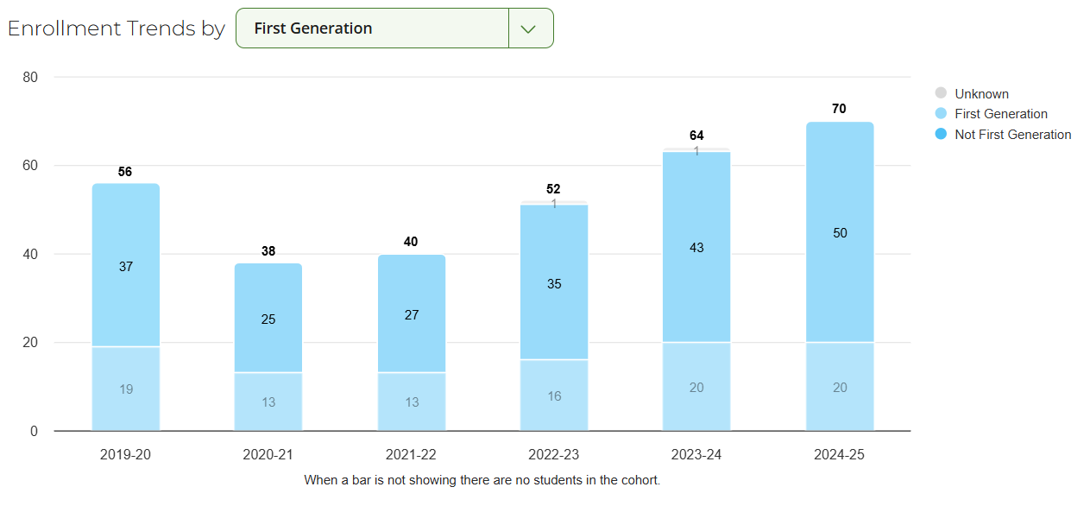
Enrollment Profile 2019-2026

Slide 27
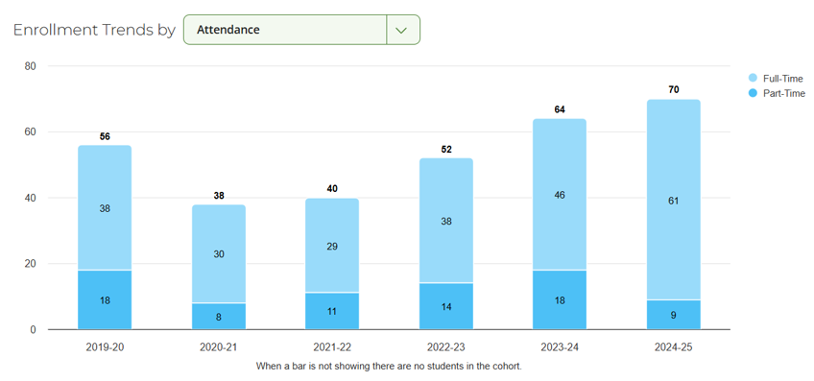
Enrollment Profile 2019-2026

Slide 28
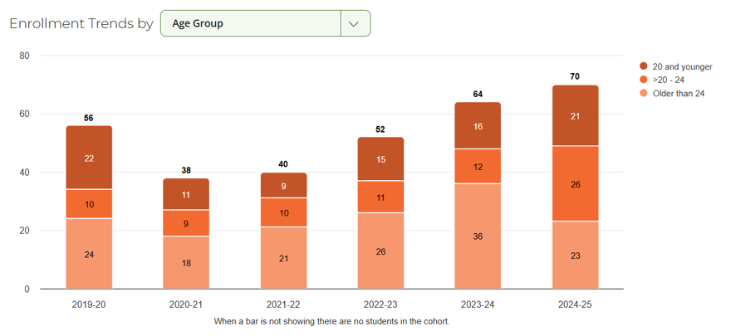
Enrollment Profile 2019-2026

Slide 29
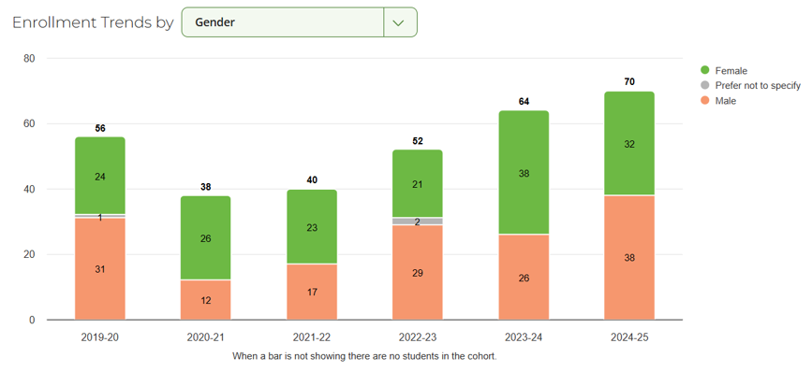
Enrollment Profile 2019-2026

Slide 30
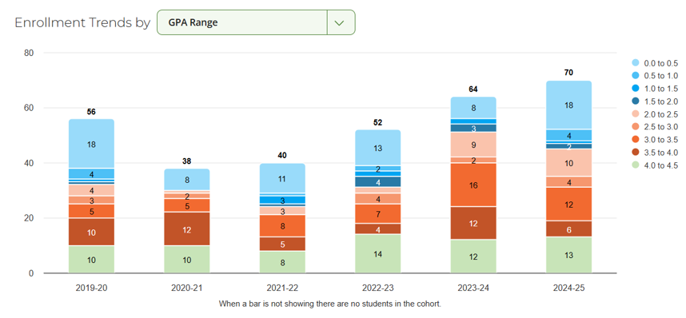
Enrollment Profile 2019-2026

Slide 31
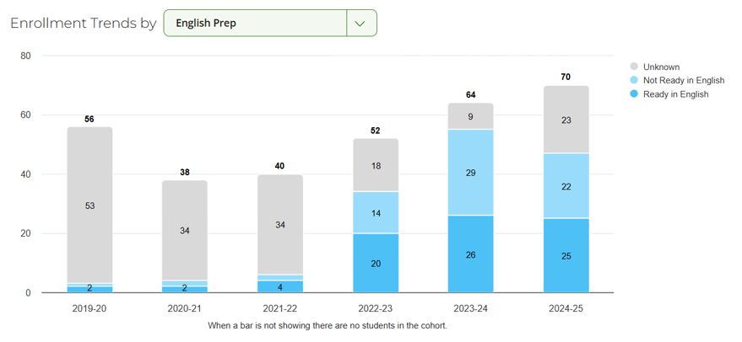
Enrollment Profile 2019-2026

Slide 32
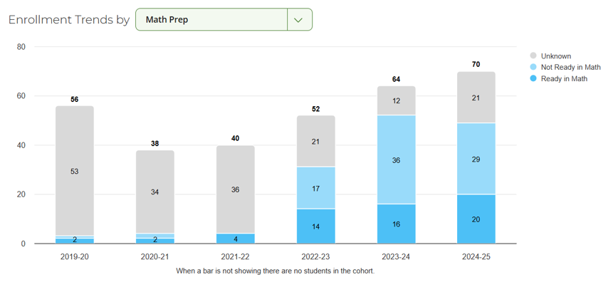
Enrollment Profile 2019-2026

